Slide 1
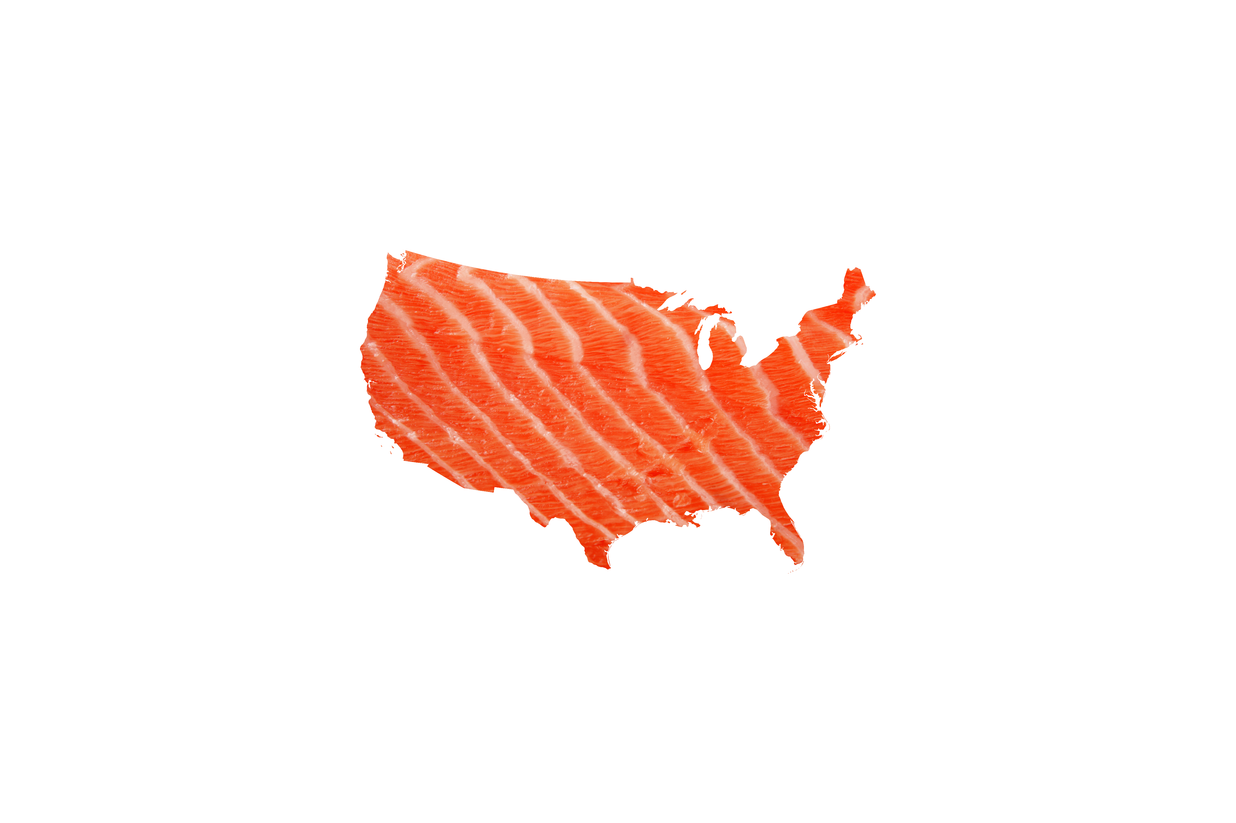


US Market
Atlantic Salmon
Notes:
Thanks Nordea and Kolbjorn for the invitation
A disclaimer: I chair the Chilean Salmon Marketing Council
CSMC is a US entity looking to enhance the reputation of Salmon de Chile, and expand US salmon consumption

Slide 2
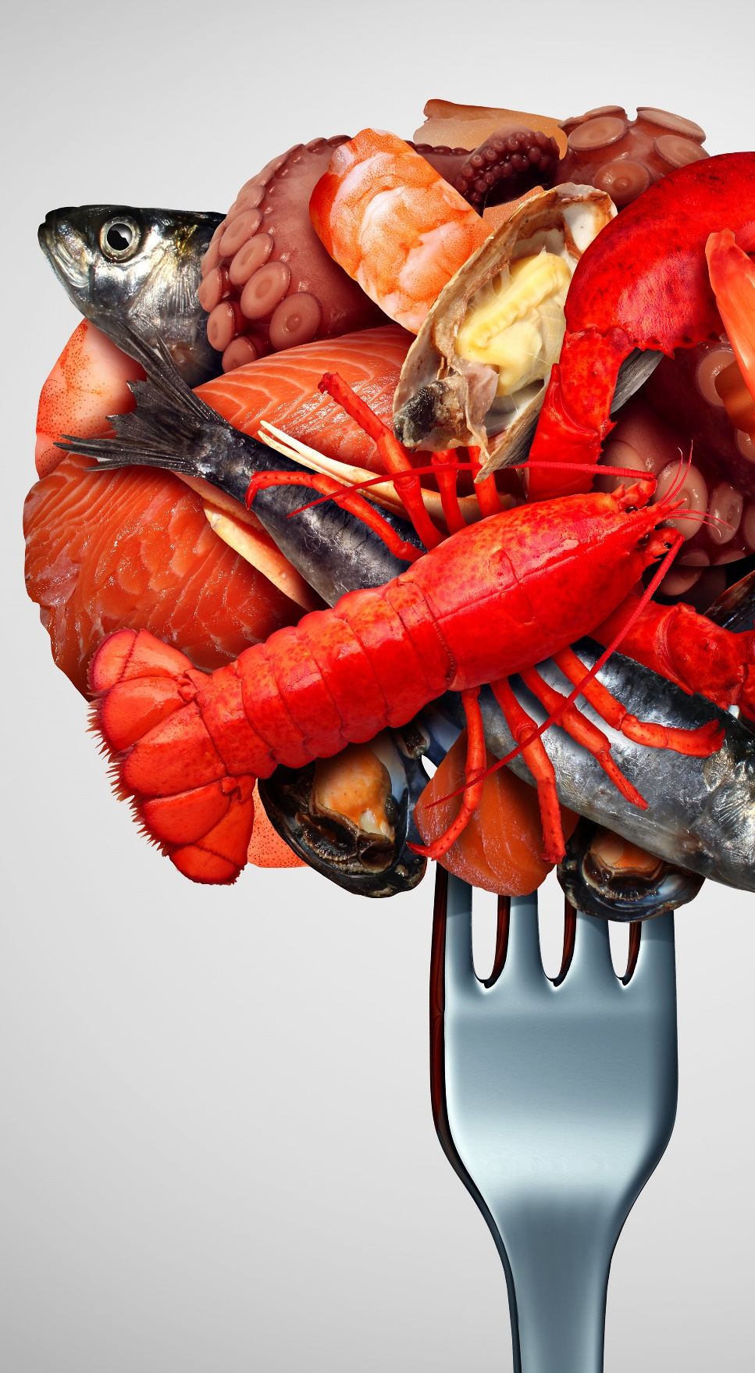
Overview of US Seafood
Fishery consumption exceeds $100 billions
But US per capita seafood consumption is only 10kg, but growing rapidly at 7-8% a year
Imports of salmon exceeds $3.5 billions and almost 600 million kg (WFE)
Over half of US seafood imports come from aquaculture.
Source: NOAA Fisheries 2017 Report
Notes:
U.S. consumers spent more than $100 billions in fishery products
Imports of fresh and frozen salmon exceed 600 million kg wfe
But U.S. per capita consumption of seafood is only 10kg a year, les than 50% world average
Over half of the seafood that the US imports comes from aquaculture.

Slide 3
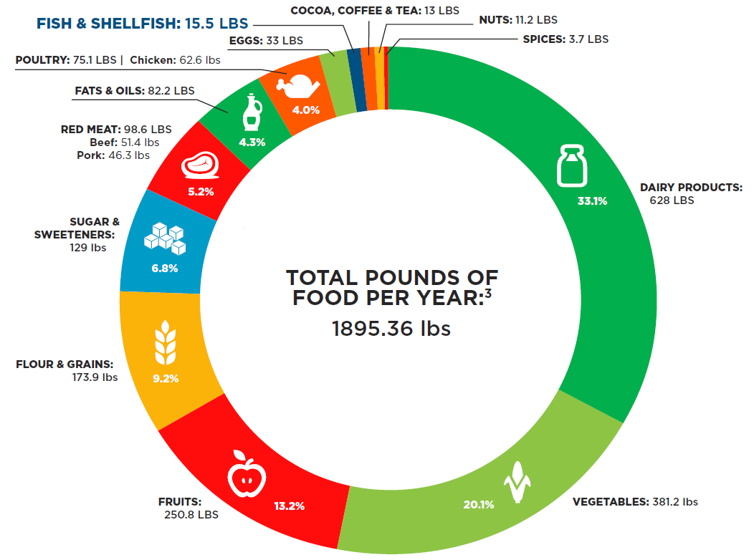

What are Americans Eating?
The Average American
America’s Top 10
Favorite Foods*
FISH & SHELLFISH
15.5LBS
1
2
3
4
5
6
7
8
9
10
Hamburgers
Hot Dogs
French Fries
Cookies
Pizza
Soda
Chicken Tenders
Ice Cream
Donuts
Potato Chips
Source: Seafood Nutrition Partnership.
Source: Data compiled from Healthy You Naturally.
Notes:
This is a country with the highest obesity, eating a lot of processed food
Americans eat much less than the recommended amounts of seafood, and 40% of world average. Why?
Cultural and historical reasons in all the middle of the US
California and Eats Coast are an exception
Lack of awareness about the health benefits of seafood
Lack of confidence in cooking seafood

Slide 4
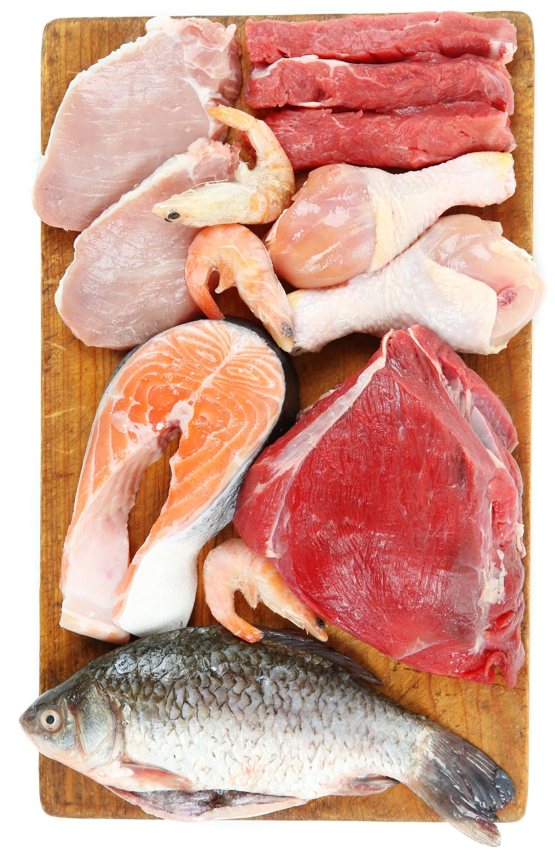




US Per Capita Protein Consumption
Total animal protein consumption = 189lbs
Salmon only 1% of animal protein
98lbs
LBS
Source: Seafood Nutrition Partnership.
Notes:
According to USDA, Americans’ annual consumption of beef is 50 times more than salmon and 6 times more than seafood in general
In vegetables, they consume 385 lb per person, while fruits are 256 lb per person.
Salmon is 1-2% of the share of meet & poulty… a tiny effort can double consumption

Slide 5
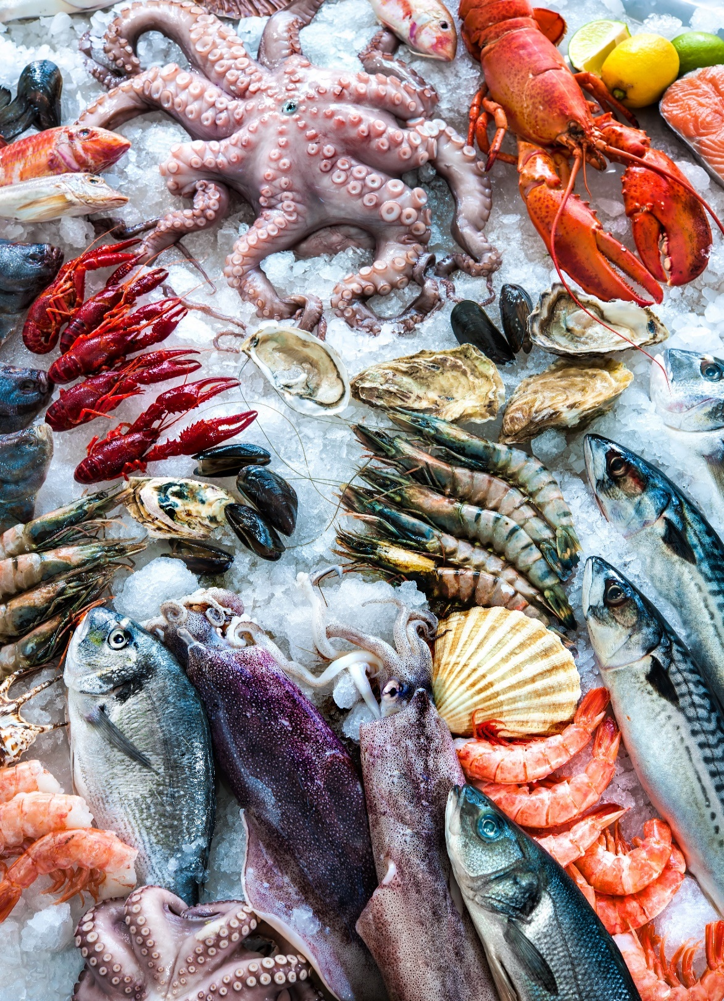
TOP 10 Seafood Species Consumed in the US
Salmon #2 with 11% increase in seafood share
Species 2017 2016 Growth (%)
1
2
3
4
5
6
7
8
9
10
Shrimp
Salmon
Canned Tuna
Tilapia
Alaska Pollock
Pangasius
Cod
Crab
Catfish
Clams
4.40
2.41
2.10
1.08
0.78
0.71
0.66
0.52
0.53
0.31
4.10
2.18
2.10
1.18
0.96
0.89
0.66
0.54
0.51
0.34
7
11
-
-9
-19
-20
-
-4
4
-9
Source: National Fisheries Institute
Notes:
In 2017 Americans grew seafood consumption by 7% but salmon by 11%.
3-4 products account for more than 50% of seafood consumption
Salmon is the fastest product within the seafood category, gaing share with all rest: 15% in 2017

Slide 6
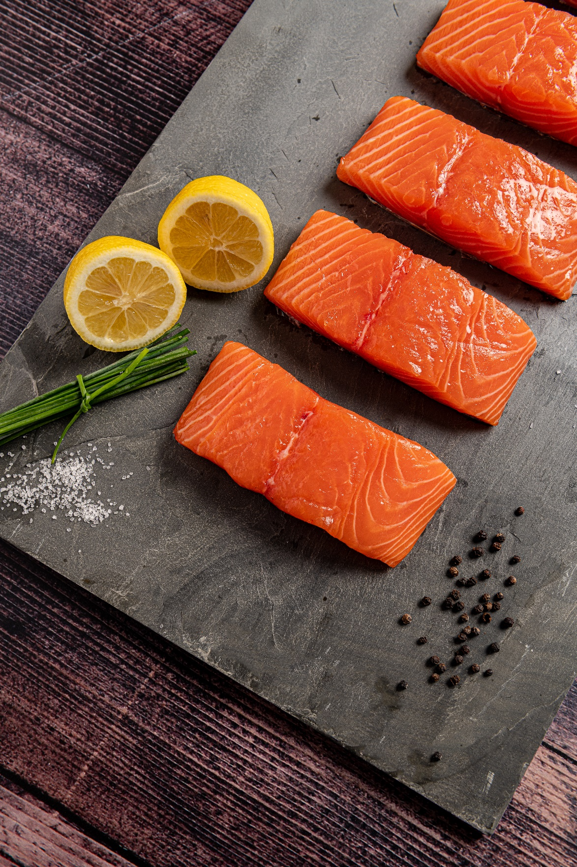
US Per Capita Seafood Consumption
2017 highest per capita consumption in 10 years, and the 6th highest ever
16lbs
2017
Source: USDA Data
Notes:
Very fast category in the American diet, but still a long way to be compare with other proteins

Slide 7
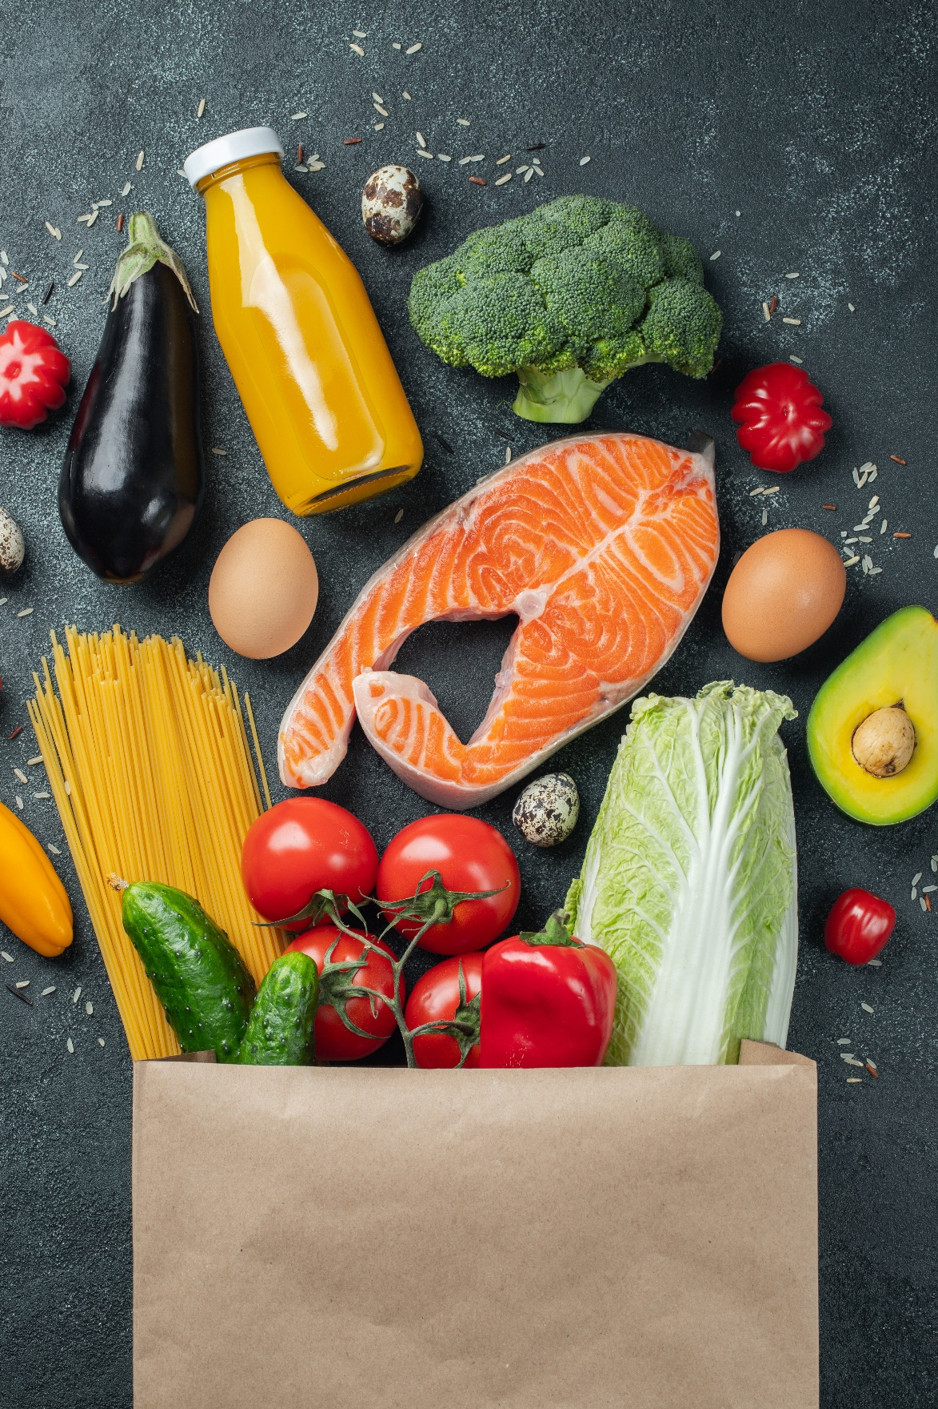





US Consumer Food Trends
Healthy Eating
Technology
Dietary needs/functional foods
Sustainability
Convenience
Source: Food Marketing Institute (FMI)
Notes:
What are the consumption trends??
Health and wellness is becoming an important driver for food purchase decisions, both retailers and food service. This is not a niche anymore.
50% consumers say they are concern about the nutritious content of their food, 29% very concern
Consumer shopping behaviors are changing with technology, and on line shopping is a key elements on retailers and food service.
Convenience remains a key driver of food sales for busy shoppers, including now deliveries.

Slide 8
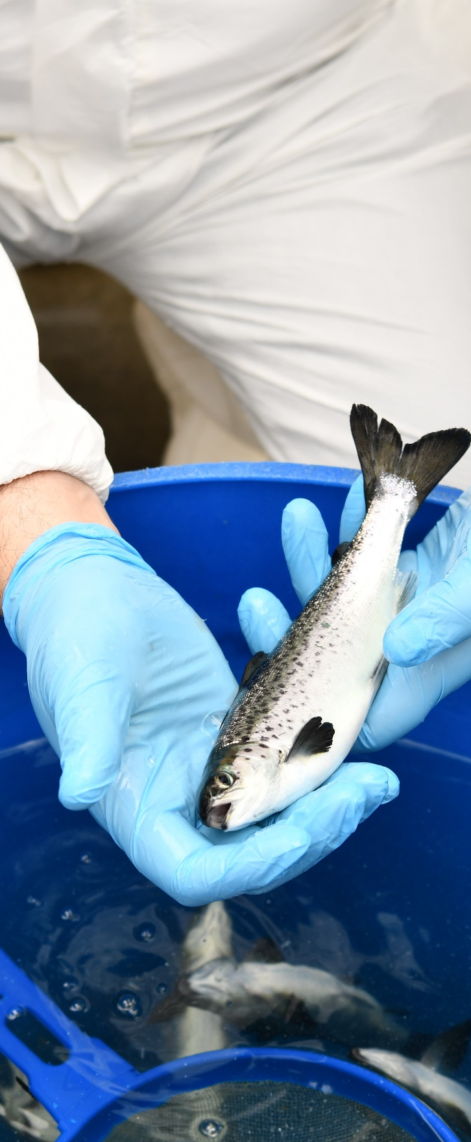
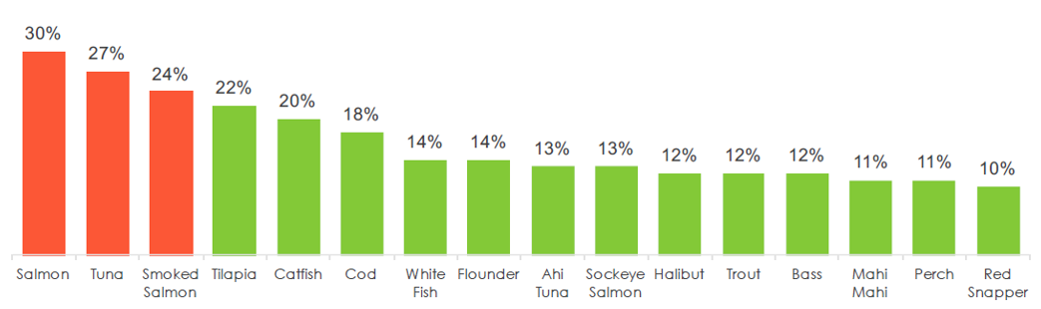
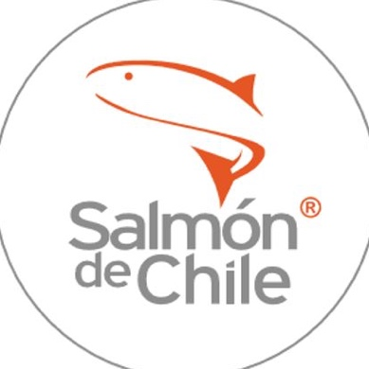
Salmon: America’s Favorite Fish
Affinity (% who love)
Source: Datassential Food with a Story
Notes:
Salmon is the “king” of seafood in the US…

Slide 9
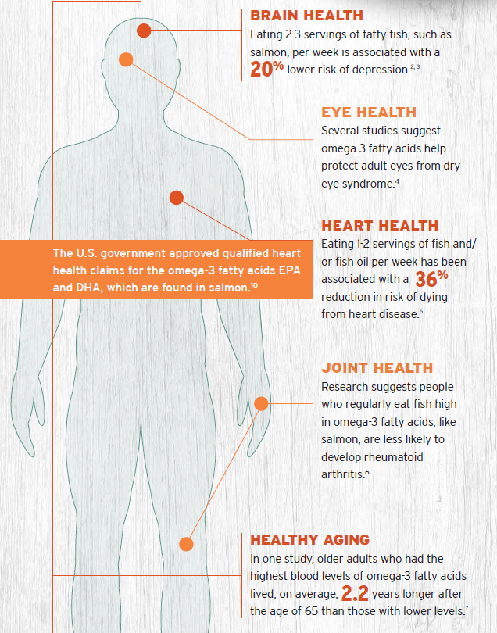
Salmon: a “Superfood”
American think that salmon has:
High levels of Omega-3
Not only has Proteins, but Vitamins (D&B12) and Minerals (Iodine & Selenium)
Has benefits for:
  Eye Health
  Bone and Joints
  Brain Repair
  Cancer Defense for anti inflammatory
  Skin
  Heart
Source: Perceptions of Chilean Salmon in the U.S. CSMC
Notes:
People in the US think that,
Salmon is perceived as one of the best sources of omega-3 fatty acids EPA and DHA, which are known to reduce inflammation, lower blood pressure and decrease risk factors for disease.
Source of B vitamins and potassium needed for energy production and protecting heart and brain health
The American Heart Association recommends eating fish at least two times per week, specifically highlighting, “fatty fish like salmon.”
Therefore, salmon is perceived to be one of the new “super food”
Which is why we are aiming to partner with the other superfoods from Chile: fruits, wine and avocado

Slide 10
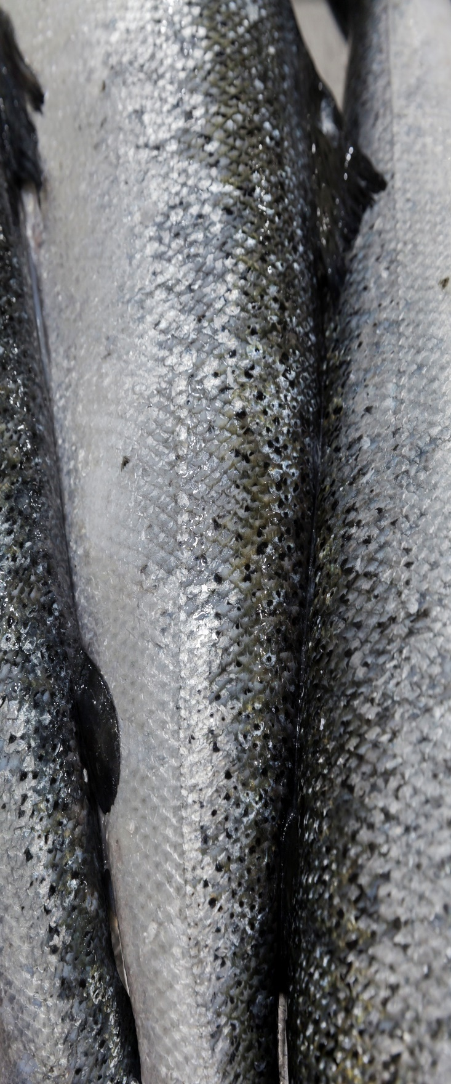

Perceptions & Preferences
67% of salmon eaten in the US is farmed and 33% is wild-caught
All projected growth will continue to come from aquaculture
Distributors and wholesalers
Retail buyers and other customers
Have belief in the farmed product and the quality it offers
Available 52 weeks per year
More “unique” and “natural”: perceived as better in quality and taste. Although farmed is relied upon product for year-round availability (and cost for some)
Believed to be some of the best fish as it is processed as soon as it is caught. Can be stored.
“Fresh is best” is the philosophy; most popular and largest proportion of salmon purchased. Shelf life and year-round availability a problem
Wild
Fresh
Farmed
Frozen
Source: Perceptions of Chilean Salmon in the U.S. CSMC – Market Research | November 2018
Notes:
Wild is preferred by consumers. The problem is that is available 8-10 weeks out of 52
Farmed salmon is reliable and available 52 weeks a years at a stable price; that’s why 66% is farmed
Farmed is preferred by seafood buyers, and they understand that any growth come from farmed
Fresh is globally preferred

Slide 11
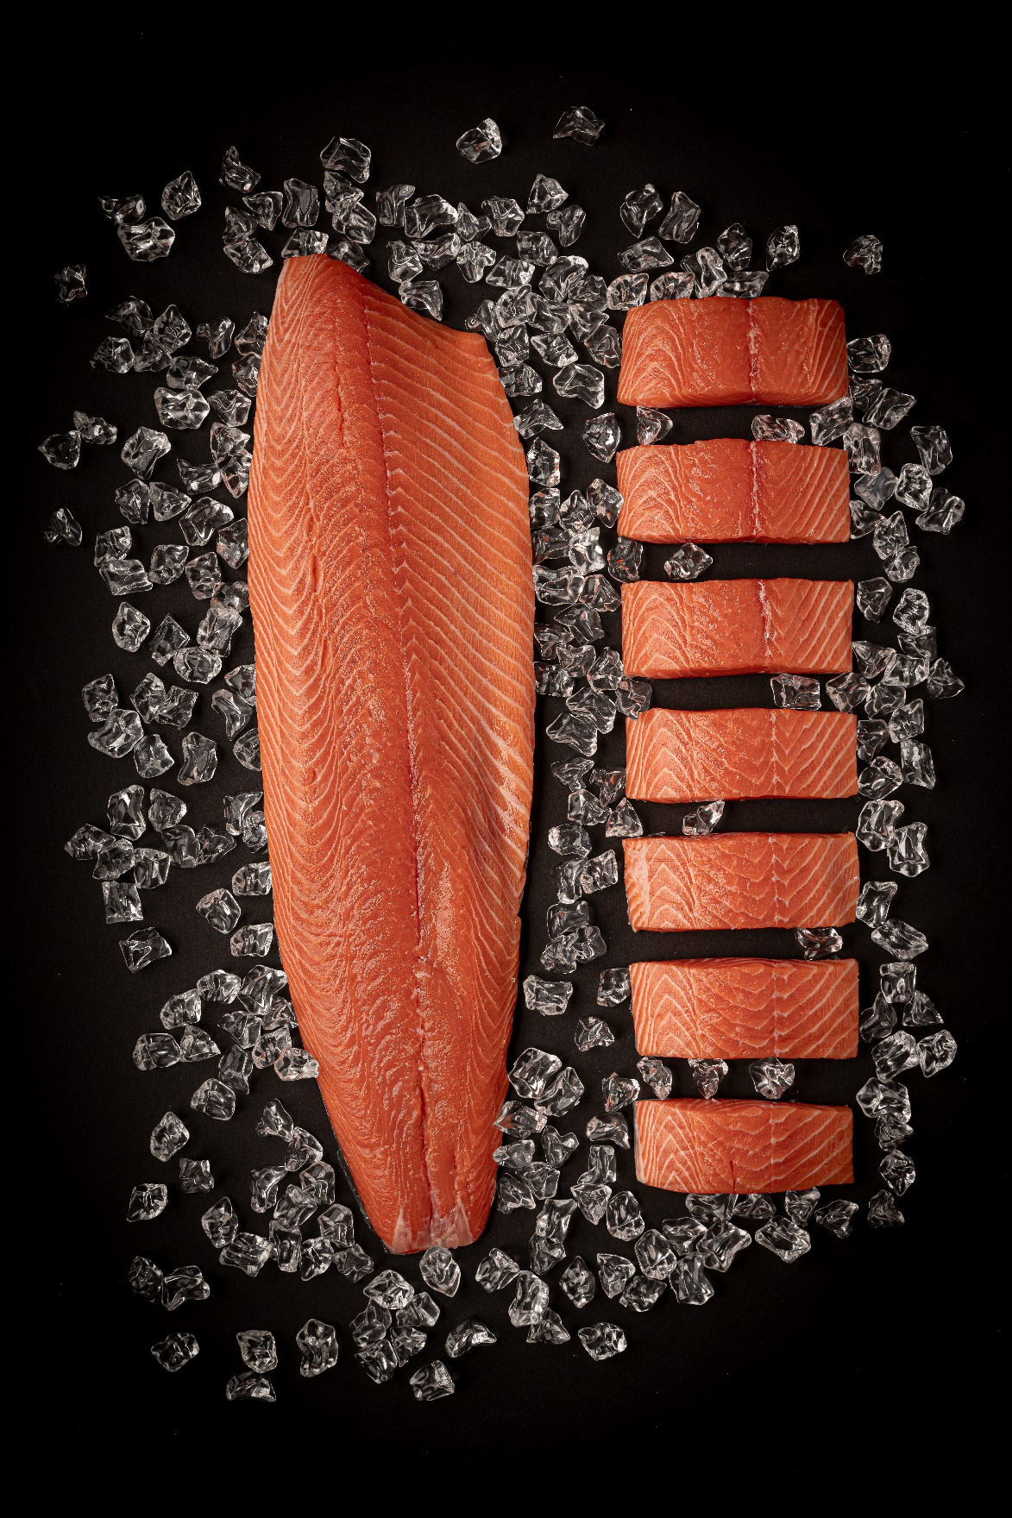
US Fresh vs Frozen Atlantic Salmon
Fresh dominates
A decrease of 4% in frozen since 2014
Source: U.S. Census, Urner Barry, USDOC
Notes:
Fresh salmon dominates sales
That includes fresh from Canada, which sells only fresh

Slide 12

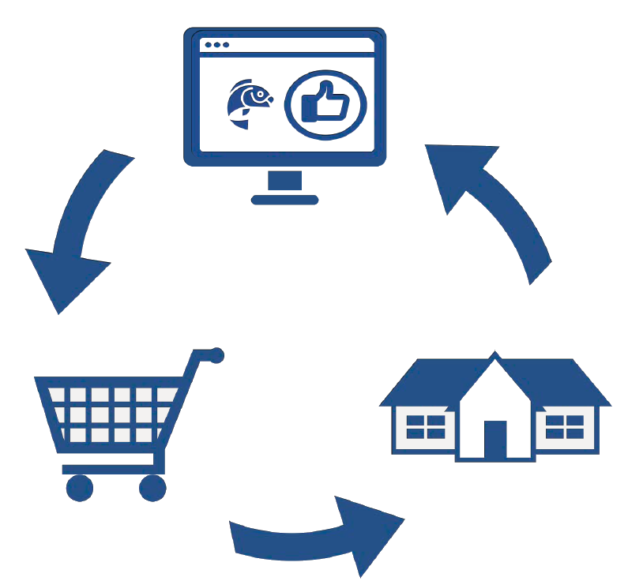

News on Distribution
Channel fragmentation continues, e-commerce gains exposure
Shopper traffic continues to spread into non-traditional channels.
Millennials driving e-commerce migration: nearly 50% of Millennials shop online for groceries.
Supermarket continues to dominate as primary store but declining from 61% in 2007 to close to 45% today.
Dramatic growth in shopper engagement for online-only stores
Online
Omni-channel Engagement
At the store
At home
Source: Food Marketing Institute (FMI)
Notes:
We are witness of fragmentation of shopper loyalty across channels; supermarkets lost 16% share in 2 years.
Around 15% of food service is expected to be online this year, with deliveries
More than half of Millennials shop on line for their groceries

Slide 13
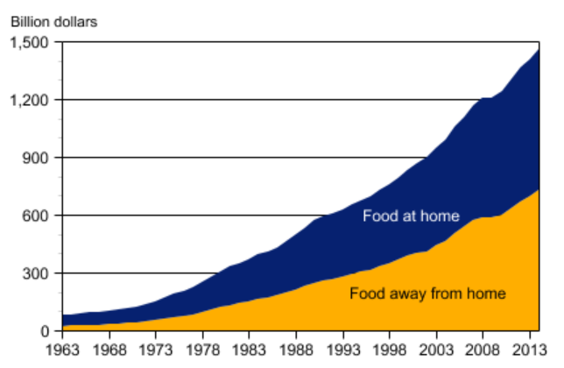
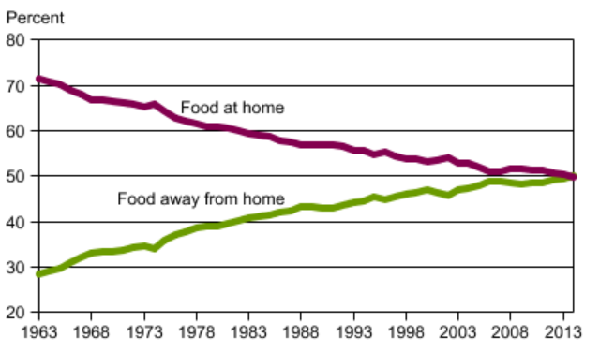
Where are Americans Eating?
Consumers are spending more money on food, at home & away
The trend is eating as much “at home” as "away from home”
Delivery and off-premise strategy potential to be 25% of restaurant sales
Expenditures for food at home and away from home
Shares of total food expenditures
Source: USDA, Economic Research Service, using data from the Food Expenditures data series.
Notes:
People eat as much on restaurants than at home…
Big role to food service buyers and restaurants’ positioning

Slide 14
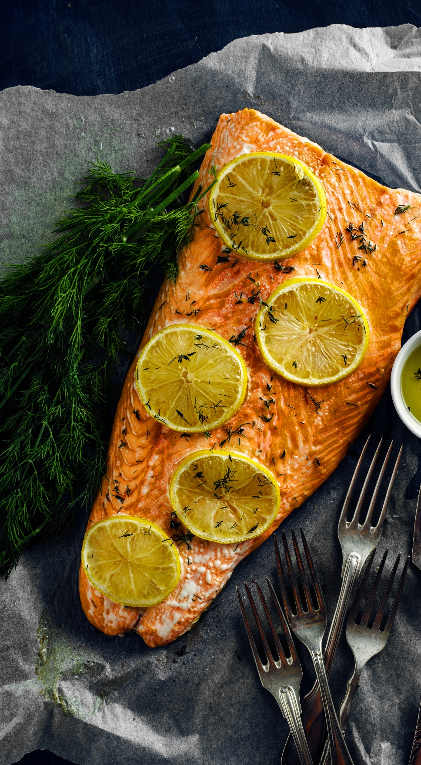
Global Production of Atlantic Salmon
Norway #1 Producer and Chile #2
2019 Global supply projected to increase 5%
2,786
Source: Kontali – May 2019
Notes:
Chile is the second producer of salmon

Slide 15

US Sourcing of Atlantic Salmon
Market dominated by Chile
Market has grown 21% over 5 years (2015-2019)
427
Source: Kontali – May 2019
Notes:
Chile is the main source of salmon to the US
The US is the main market for Chilean salmon
Conclusion: Chile has to focus on this large market and build up a story

Slide 16

Retail Pricing Overview
Retail Pricing, Atlantic Salmon Fillets
Source: Urner Barry, Retail database available in www.ubcomtell.com
Notes:
Favorable price environment. Except for 2012 hen Chile was coming back from ISA and 2015 with major devaluation on non-dollar currencies, there has been a smooth increasing path
Prices increasing 3% per year on average, and a smoother ride in last couple of years, is helping create demand and facilities the retails and food service

Slide 17
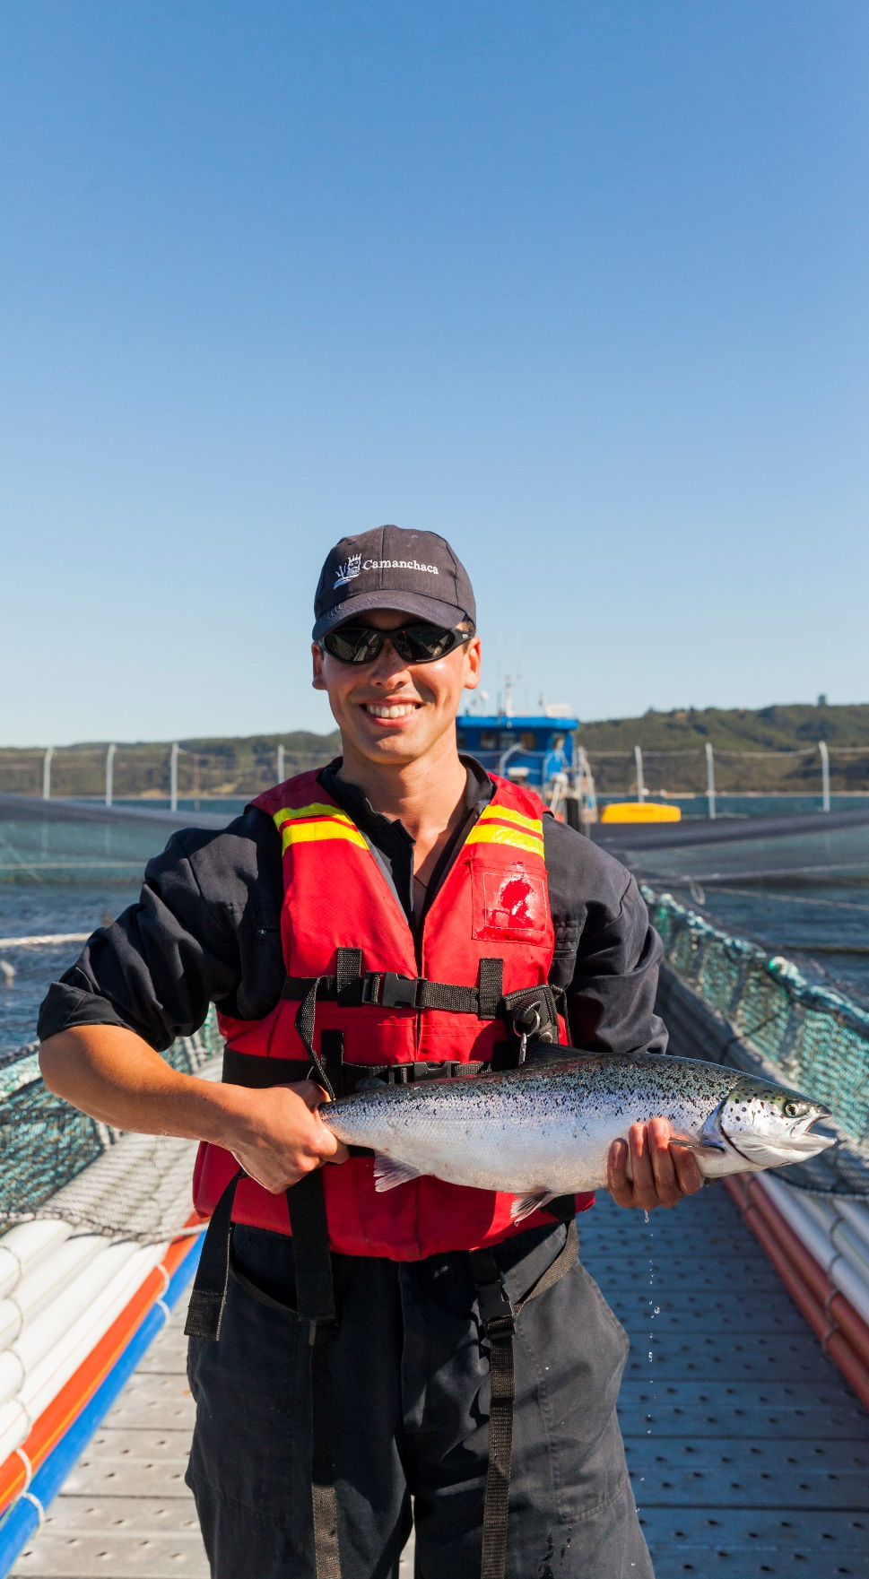
The State of Transparency
US Consumers are increasingly expecting retailers/restaurants to tell the story behind the food and how it’s produced.
  They need to know better its main salmon supplier
Salmon de Chile has an opportunity to shape the market, by telling its story to our main customer: the US.
Story is about,
  Chilean Patagonia, our farming territory, has favorable positioning with U.S. consumers and stakeholders in general.
  Chilean Government has strengthened regulations to ensure industry’s progress comes with sustainable environment and fish wellness
  Chilean industry has made substantial progress in sustainably farming salmon.
  Nutritious value of Chilean salmon is as good as other origins.
Source: CSMC Perceptions of Chilean Salmon in the United States 11/30/18, 1/4/19
Notes:
Transparency is about a rational need for information as well as an emotional desire for genuine connection
93% of US consumers says brands has to provide detailed information about what is in the food and how it’s being made.
There has been a dramatic increase 39% to 74% in 2 years of those who say they would switch from to a brand that provides more in-depth product information

Slide 18
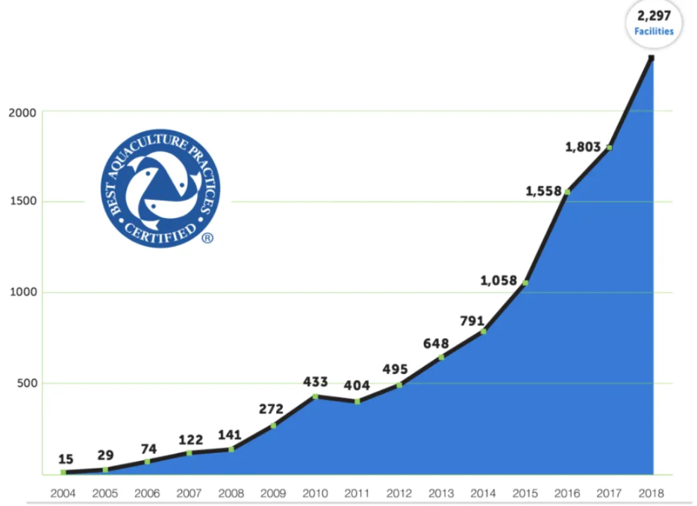

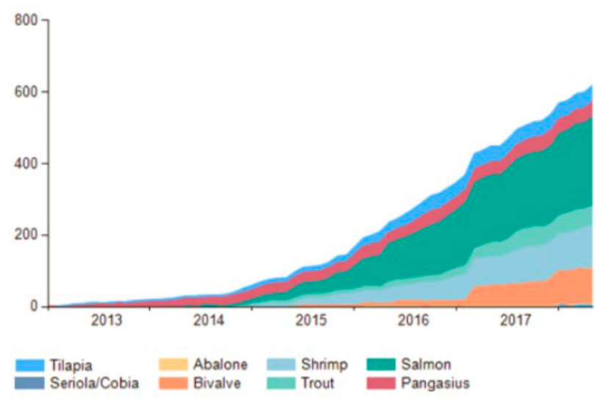
Transparency & Certifications: BAP vs ASC
Transparency beyond the package
Number of BAP Certified Facilities
Number of ASC Certified Facilities by Species
Includes Processing Plants, Hatcheries and Feed Mills (through December 2018)
Tilapia
Cobia
Abalone
Bivalve
Shrimp
Trout
Salmon
Pangasius
The BAP programme tripled in size in the 4 fours years
+1.5 million tonnes of seafood now BAP certified
+2,280 certified facilities
ASC programme keeps growing +1000 certified farms around the globe
+1.7 million tonnes of seafood now ASC certified
+18k ASC labelled products worldwide
Source: 2019 The Global Aquaculture Alliance
Source: 2019 Aquaculture Stewardship Council
Notes:
Transparency needs to be operational, and that’s the role of certifications
Retailers who inform are better positioned to build trust and loyalty.
Shoppers are asking retailers for help in knowing the story behind the food they are eating.
BAP certification counts for about 1,500 million tonnes of annual production, or 2,287 certified facilities, 2/3 of which are farms
It outnumbered ASC in the US and has good connection to retailers.

Slide 19
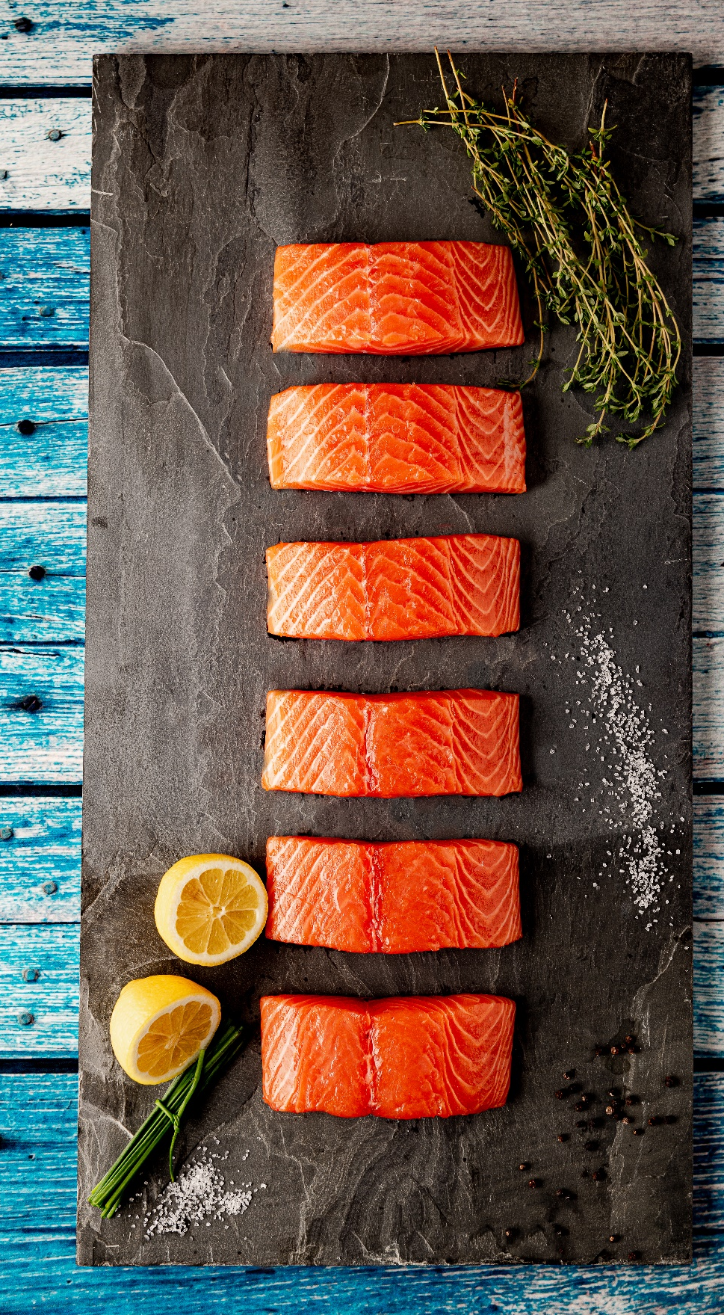
US Market in summary
Very low US per capita consumption of salmon
Increasing demand for healthy protein & superfoods
New distribution channels (ecommerce, drug stores, convenience stores)
Enablers
  New product forms: value-added, ready to eat, grab-and-go
  Information on how to cook
  Improving frozen perception for cooking flexibility
Large space to create demand: need to build a story around salmon
Notes:
There is a large room to increase per capita consumption, with less than 2% share of the meat market.
Healthier consumption is becoming a driving force in a market with the largest obesity in the world
New channels are facilitating the process and accessibility to ready to eat
A broad effort has to be done in teaching how to cook and the benefits & flexibility of frozen formats: people have it with beef and chicken
Around a story of salmon, much demand can be created: all salmon farmers need to work on this: the state of the market is for collaborative work on the category.

